Slide 1
How to make a ladybird.
How I made one.
by Arthur Dibble
arthur@whkf.org.uk
Please note; this is a work in progress and may be updated at any time when I find better ways of doing things.

Slide 2
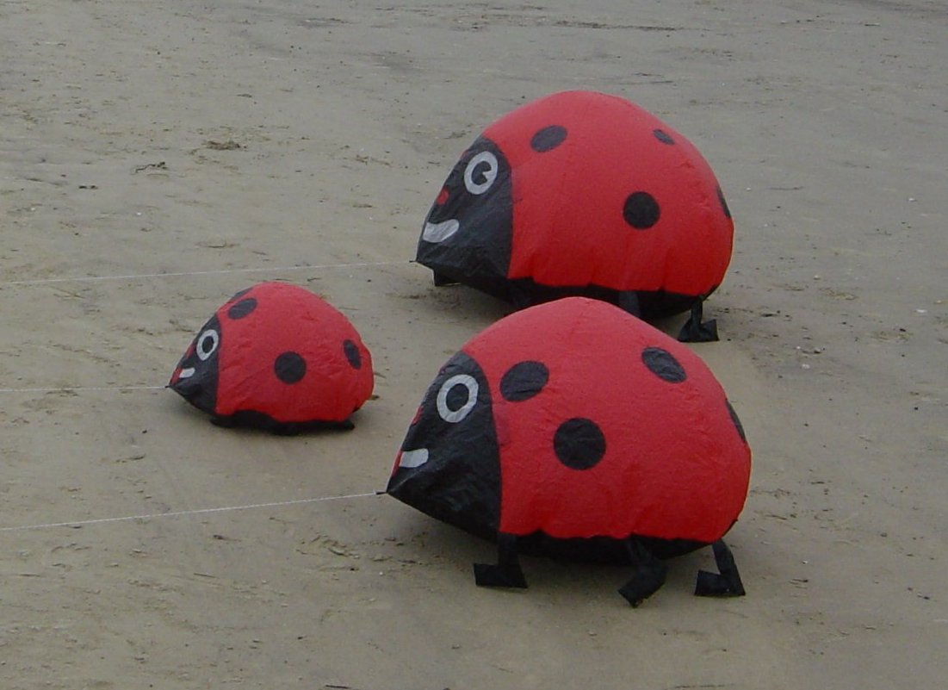

Slide 3
The origins of this design are by Geoff & Carey Campbell NZ .
The plans with text in German can be found at :-
https://www.kiteplans.org/planos/marienkafer/Marienkaefer-HoHi.pdf
I am indebted to Bernd Kunze for supplying me with an English translation that I have rearranged to make it more readable. Then I hope the rest of the presentation will help any one making a Ladybird for the first time.

Slide 4
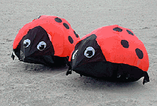
Blueprint ladybug
by Geoff & Carey Campbell NZ
Text and photos: Schmidts-Pit
These beetles were one of the absolute eye-catchers at Fanö 2004. This was built by an Englishman. However, when asked about the plan, I got the answer that I should ask Richard Wotton from New Zealand. And so Geoff and Carey Campbell gave me the blueprint with the accompanying story:
"The plague begins!"
In February 2003, after many days of kites with little wind, Geoff and Carey Campell decided that they wanted to "decorate" the floor. On their return trip from Wellington to Wanganui and their preference for ladybugs, the idea for the beetles came up. The very first evening came up Prototype! Long hours were spent reading insect books and searching the internet for how many spots a ladybug actually has. Experts spoke of 2 to 11 points, so they chose seven points for aesthetic reasons the "bouncing". Now they went to the rest of the bags with spinnakers, because there should be a mother who would take care of the little beetles. However, Geoff cut a pile of brown pieces. These lay around for days, because Carey simply refused to build a cockroach. Then Geoff took pity and built it later. So far, the beetles have spread to New Zealand via Christchurch and Nelson to Australia, then further to England, Wisconsin (USA) and even Fanö.

Slide 5
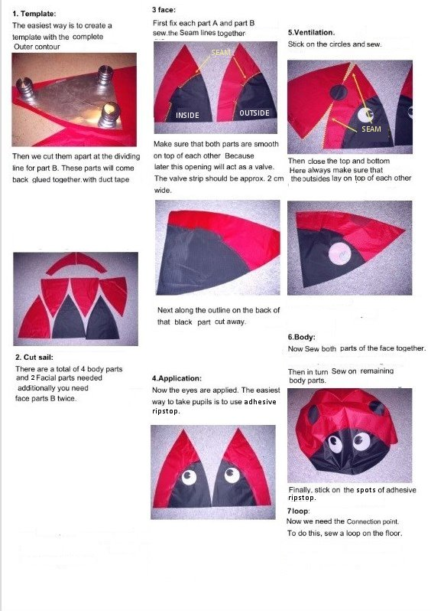

Slide 6
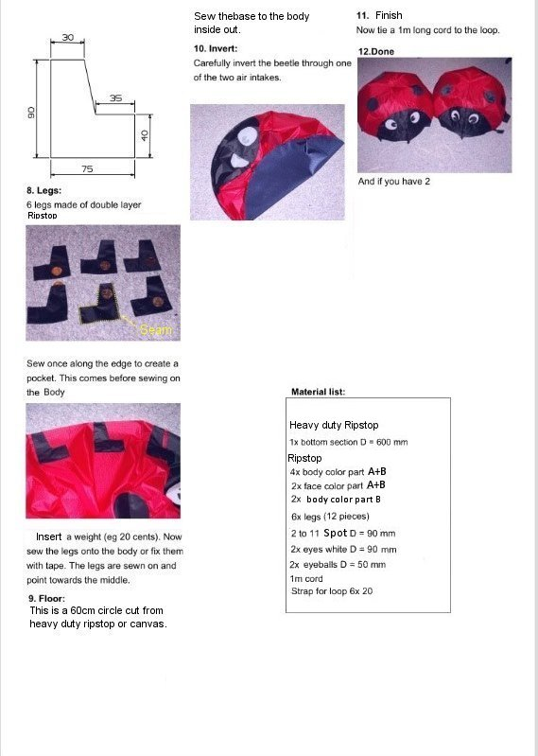

Slide 7
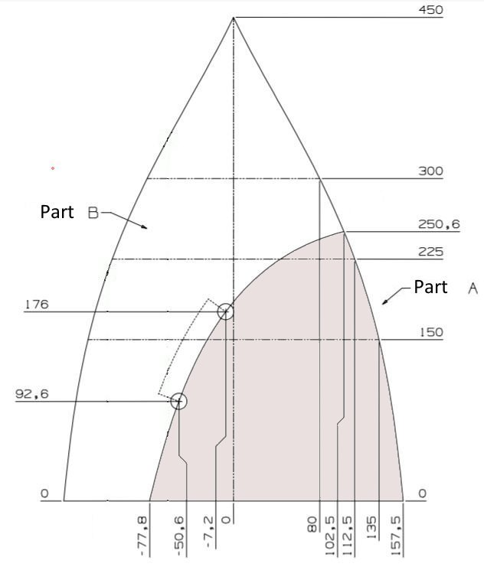
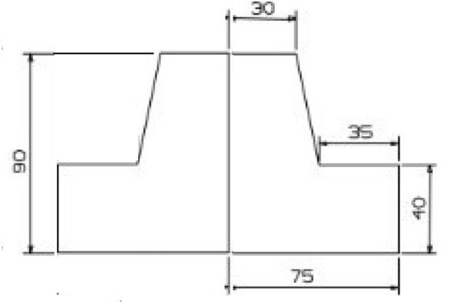
The first task is to create a set of templates. Parts A & B should be cut as a single piece and then cut along the curve. When cutting the body panels the 2 parts can be held together with sticky tape or place a weight across the join.
You will also need a template for the feet. I made a double one by drawing one and a mirror image along the long edge. This saves on cutting and sewing.
Finally you need circular templates for the Spots, Eyes and Pupils; mark the centre of these to assist with locating them when you are attaching them to the body panels.

Slide 8
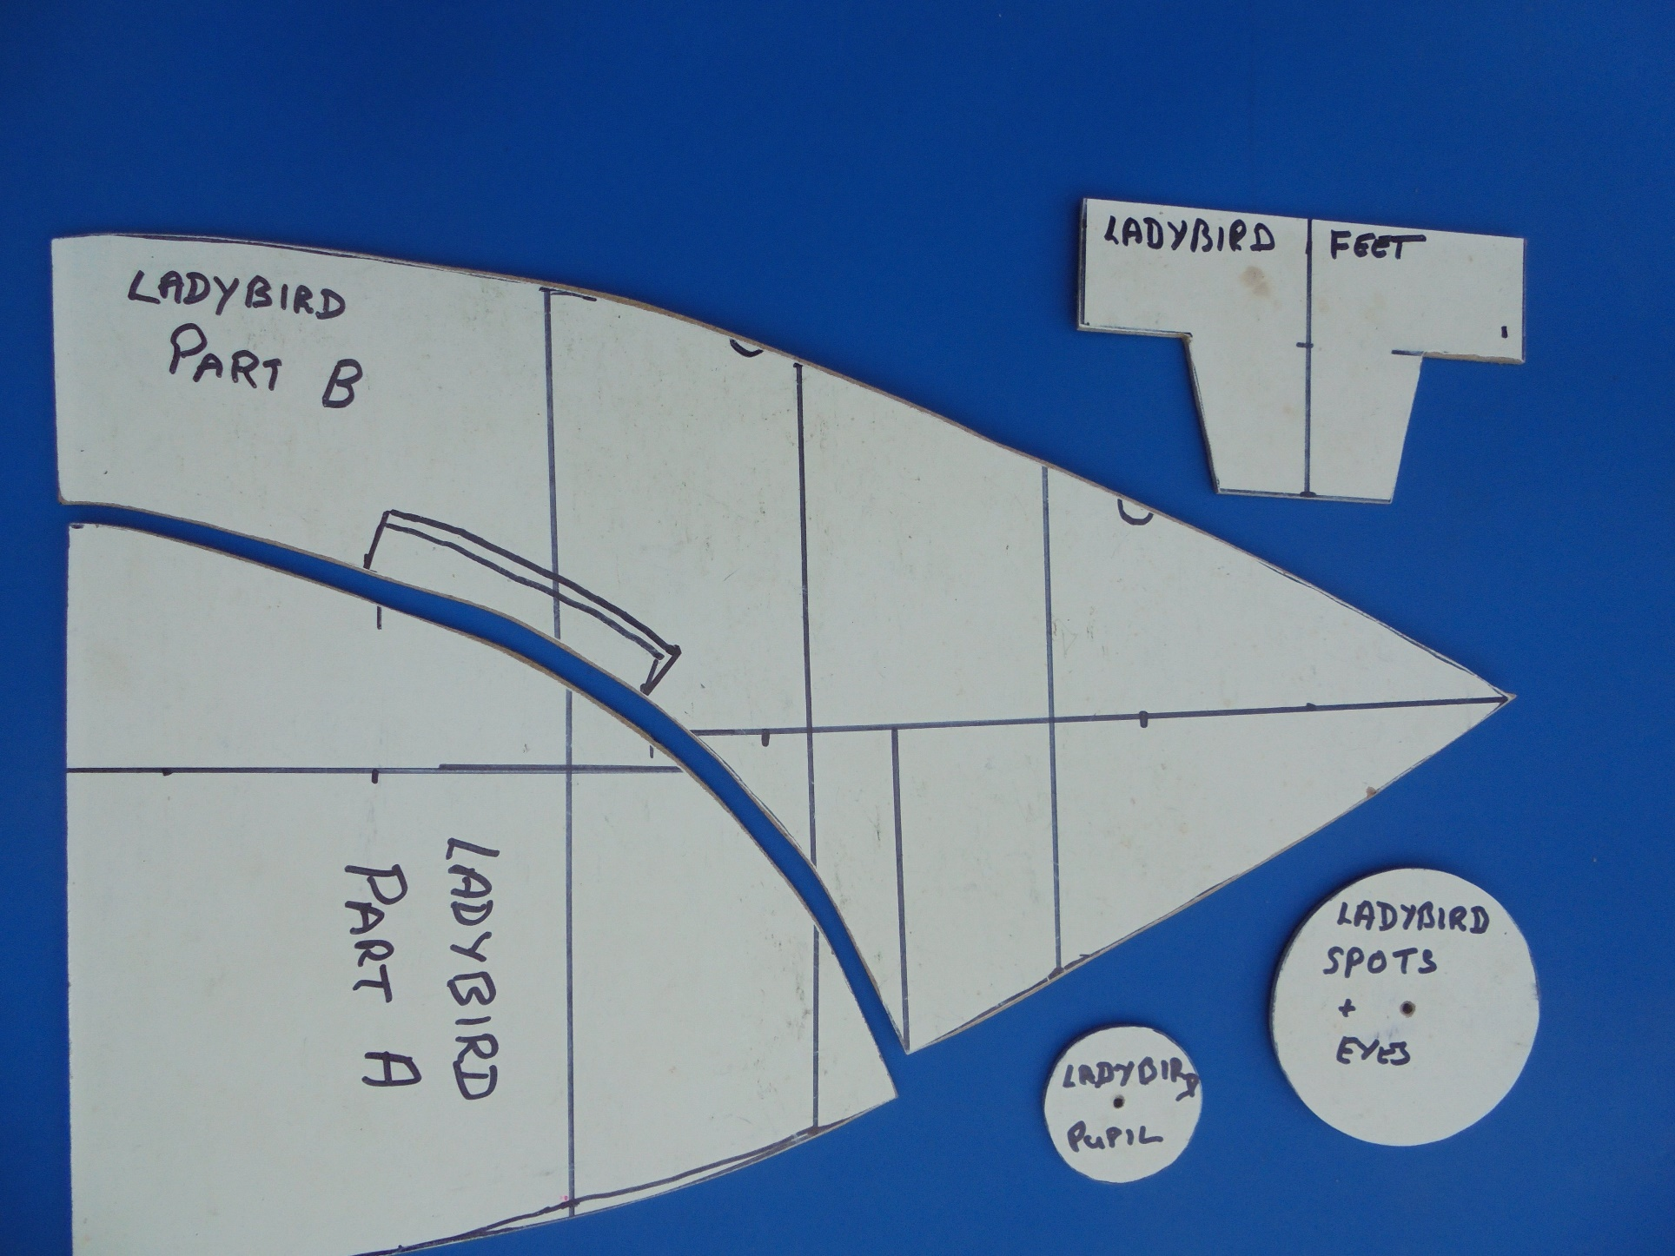

Slide 9
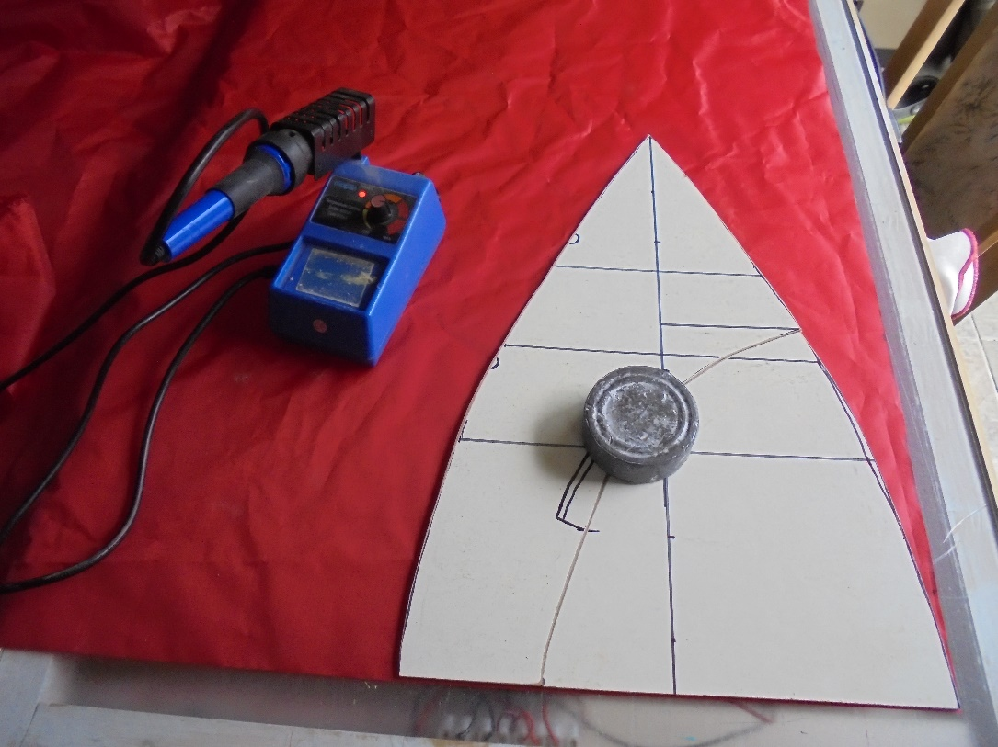
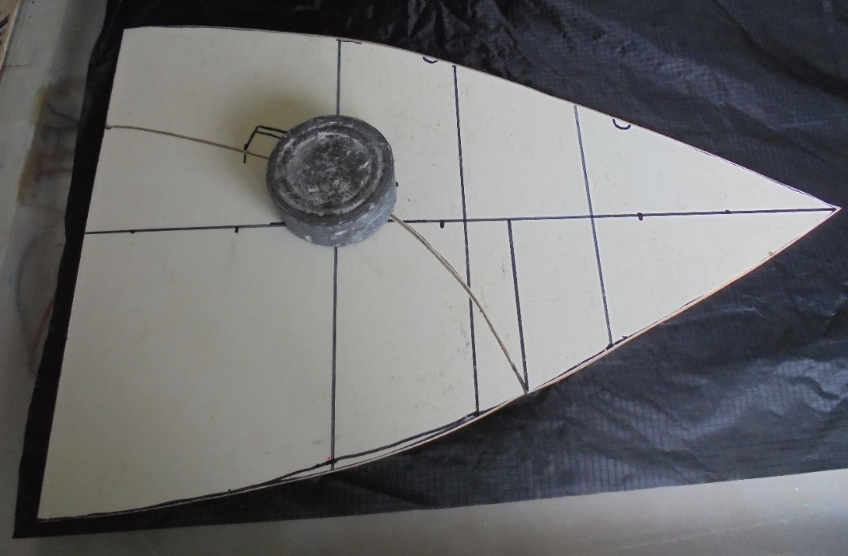
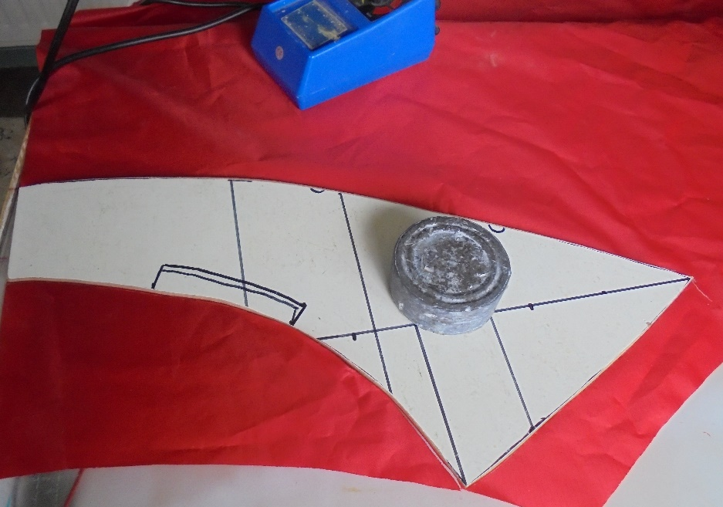
Cut out 4 pieces of body colour and 2 pieces of face colour using the full template. (Once you have made your first Ladybird and understand the procedure you can reduce the height of the face pieces to save material). Next 2 pieces body colour part B only. Cut along curve without cutting the marked inflation slot. Note: to keep the surfaces the same turn the template over for the second one.
Next you have to cut out 6 foot pieces (12 if you are using the original single sided design). Now 2 eyes and 2 pupils and then however many spots you require.
I did all my cutting with a hot cutter on a glass light box.

Slide 10
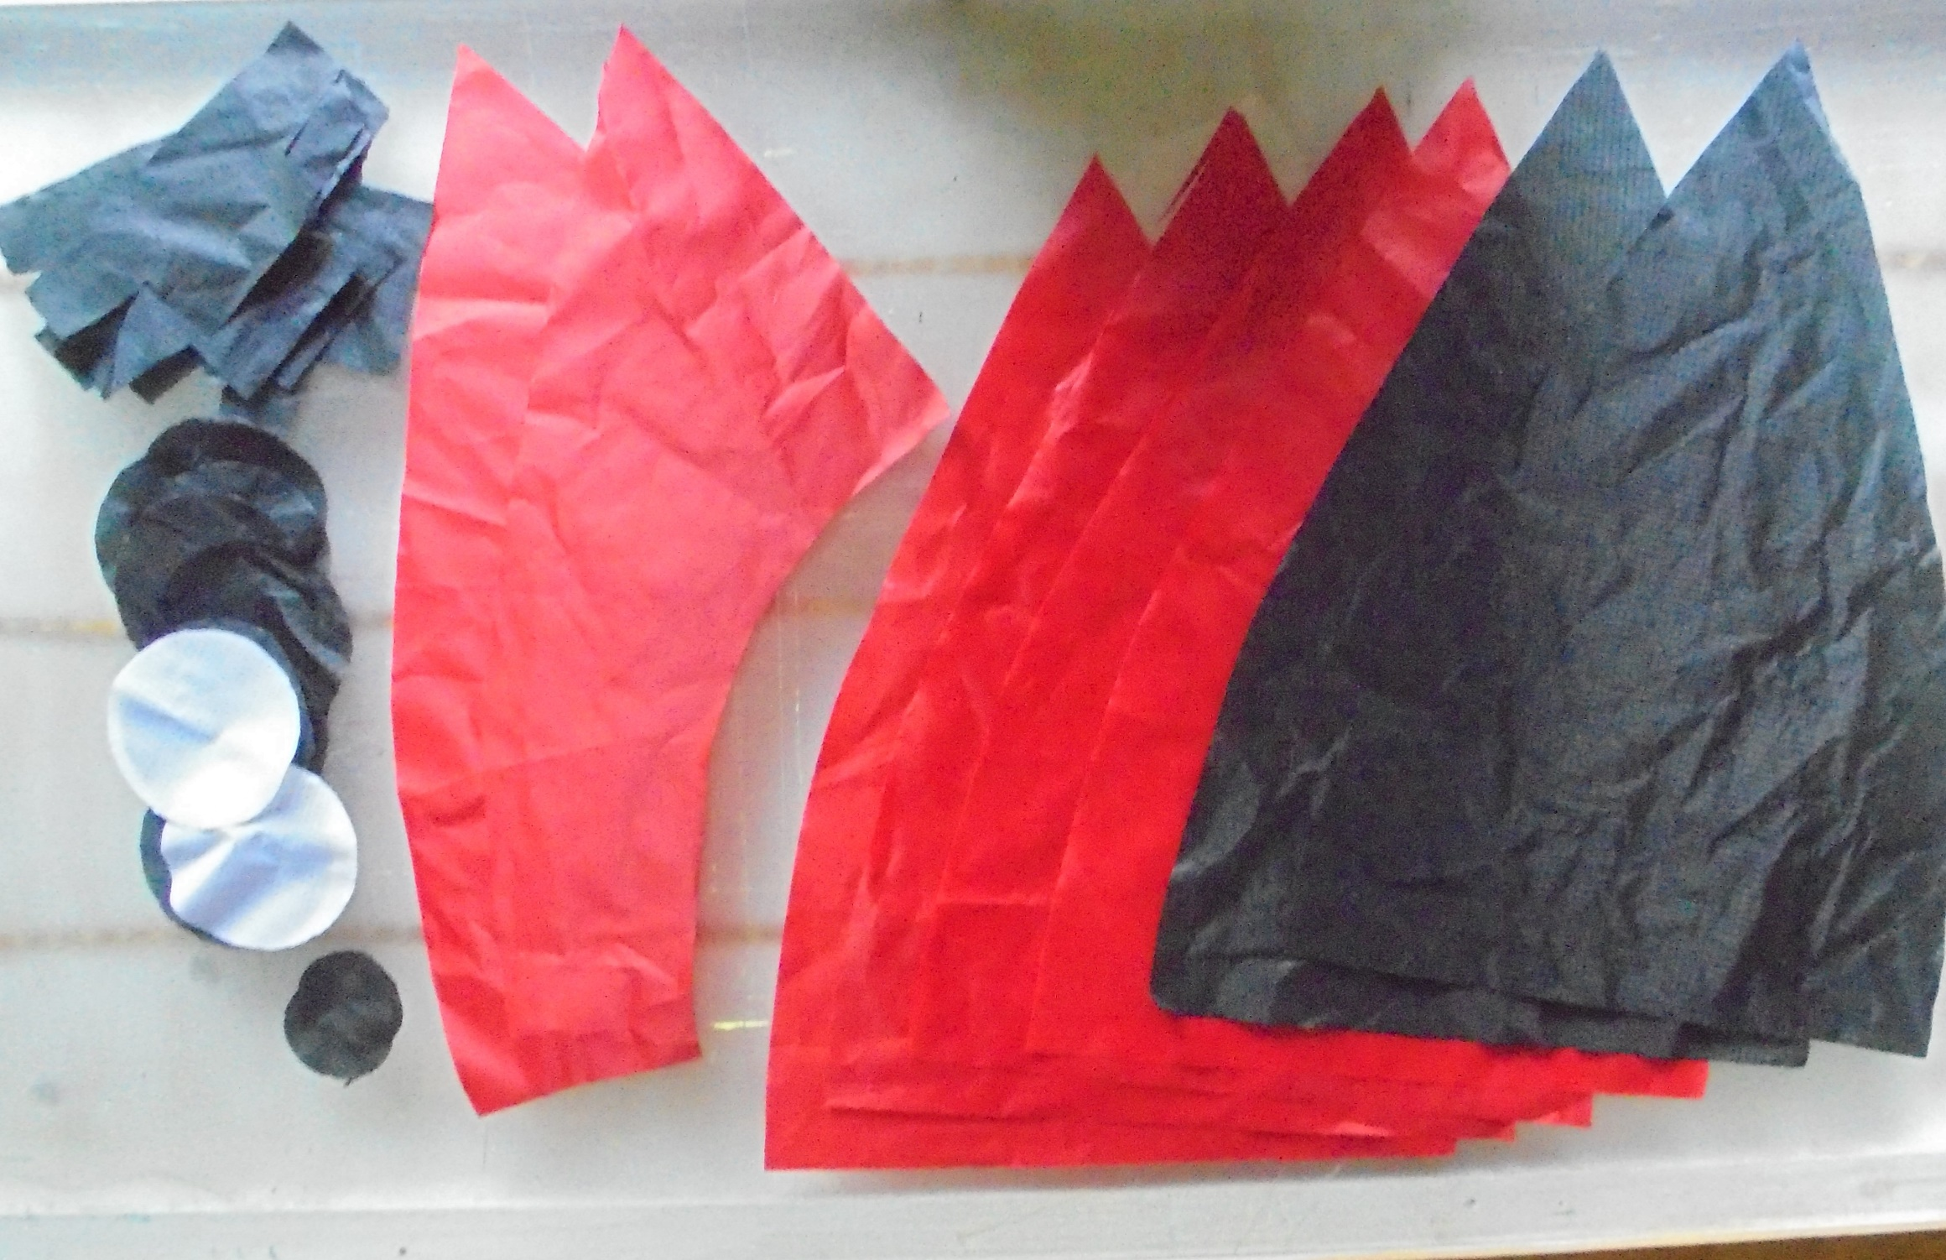

Slide 11
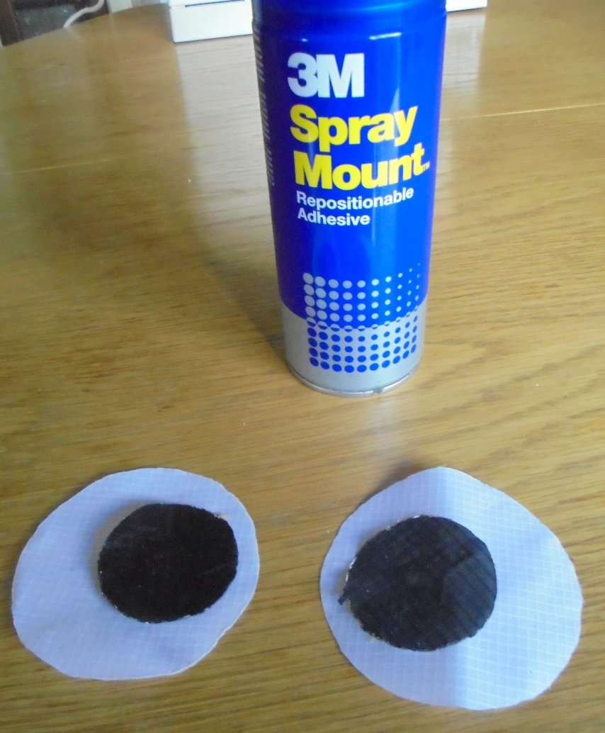
The original design uses self adhesive ripstop for the eyes, pupils and spots. I did not have this available so used non adhesive and “Spray Mount” to tack the parts together before sewing them.

Slide 12
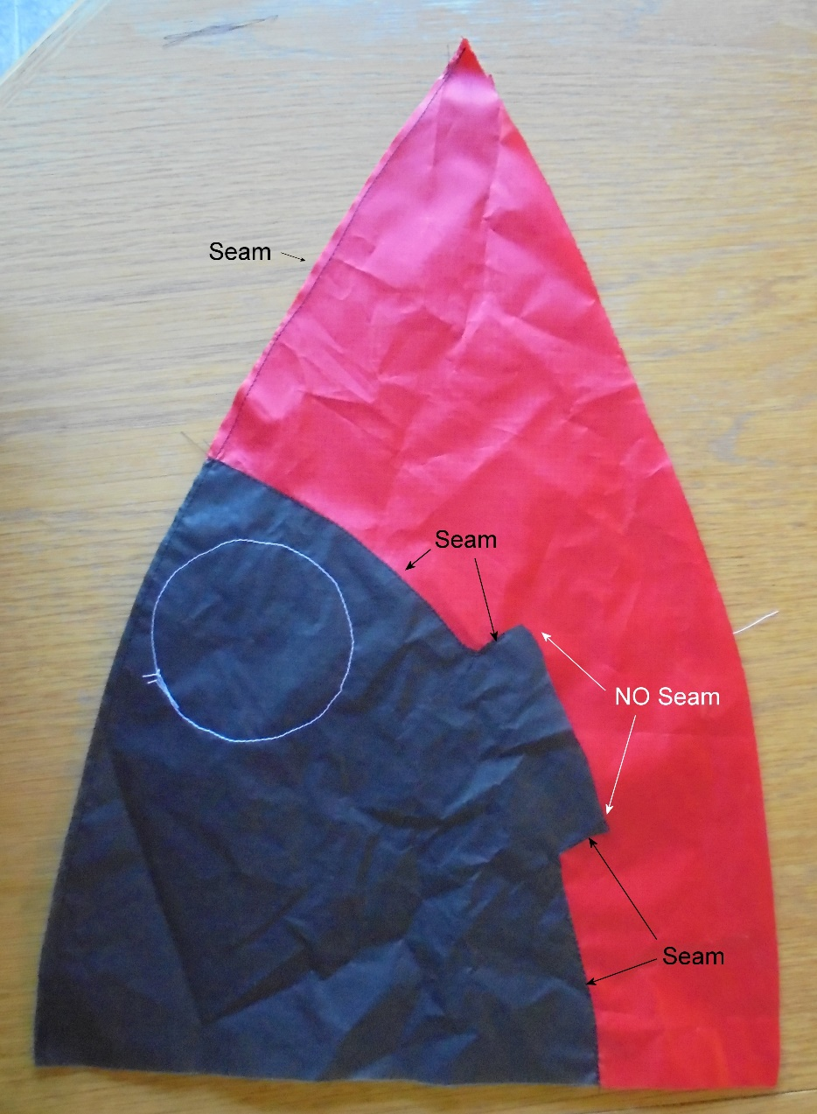
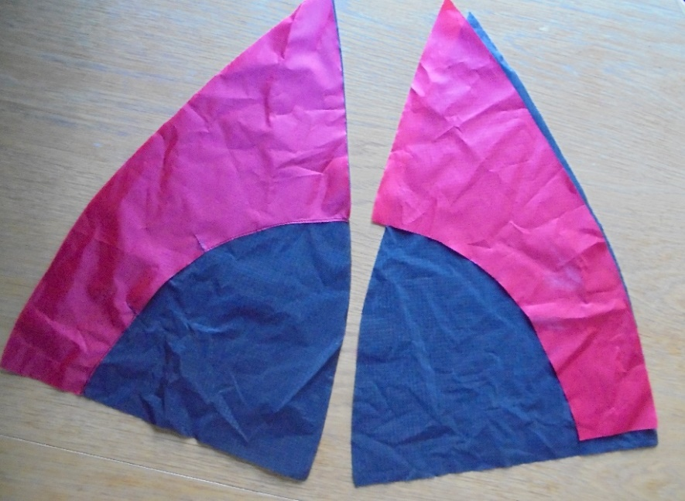
Carefully align parts B over the Face parts so that you have a left and right hand. Working from each end, sew along the curve and in 2cm on the vent flap. Do not sew along the vent flap. This is an overlap seam and should be as close as possible to the edge of part B without compromising the strength of material.
Now turn them over and cut away the excess face material. These off-cuts can be used for cutting spots.
It is a good idea at this point to add the eyes, and a spot if required, to the front of the face.
Lay the two completed face halves on top of each other with faces together and sew down the curved edge.
If you want to add a mouth, this is the time.

Slide 13
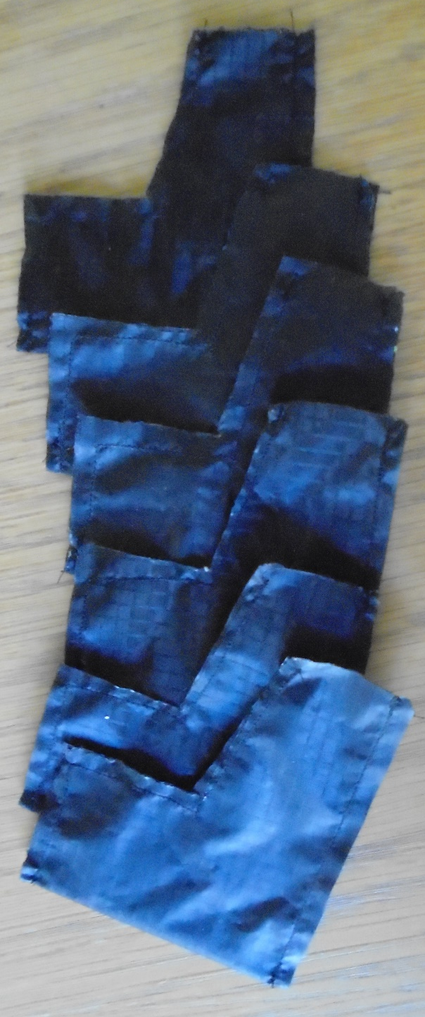
Add spots to the 4 body pieces. The choice is yours. In nature they seem to be random as to how many and where; so you can’t get it wrong.
At this point I went away from the original plans.
Open out the face and lay the next body piece over the half face and sew a seam down the edge. Doing this I should perhaps have added a seam allowance to the template?????? Continue adding panels to each side and when you have all 6 pieces fitted join the back 2 together. You may find it easier to join the panels in pairs and starting sewing each pair from the top. This gives a better finish at the apex.
If you are using my “Feet” template fold each foot in half and seam along the bottom and front edges leaving the top open. Insert a small weight in to each foot. The original suggests a 20cent piece but having no idea how heavy they are I used 2 X 20mm washers. It is probably not critical as their purpose is to stop the Ladybird turning over.

Slide 14
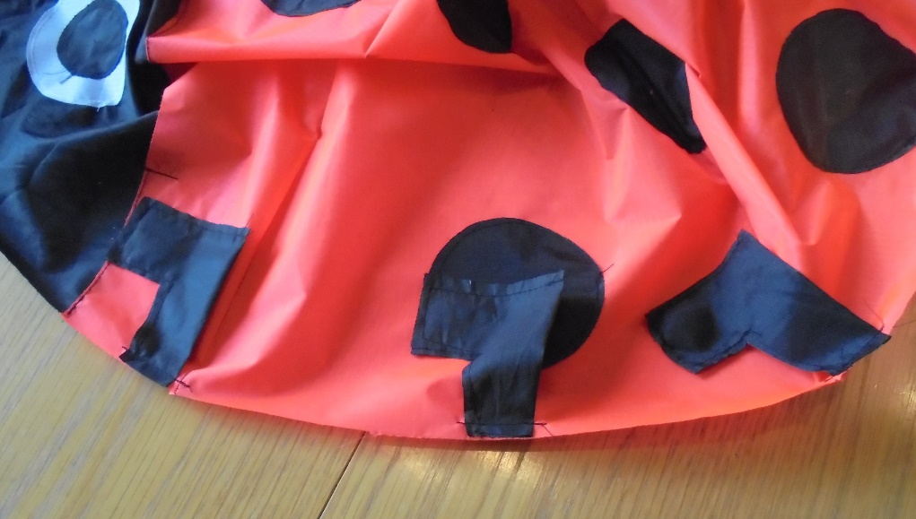
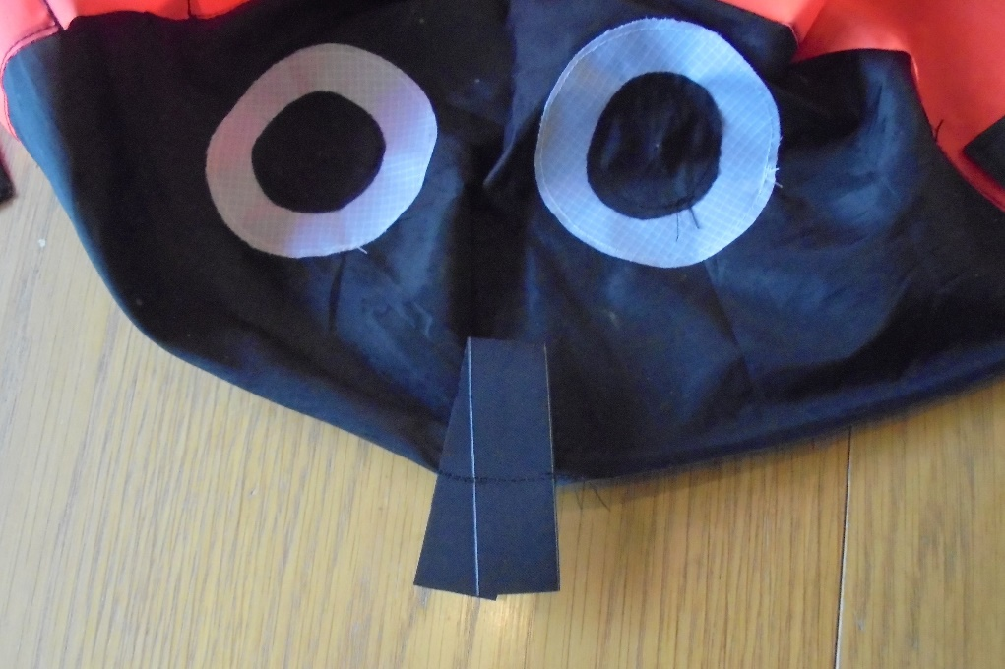
Attach the legs to the outside of the body pointing forward and lying inwards. The position of the legs is again a personal choice. I used fore, aft and centre of the first full body panel each side.
Attach a loop of strong tape or folded ripstop across the join between the face sections and pointing inwards. Sew it along the circumference similar to attaching the legs to the main body.

Slide 15
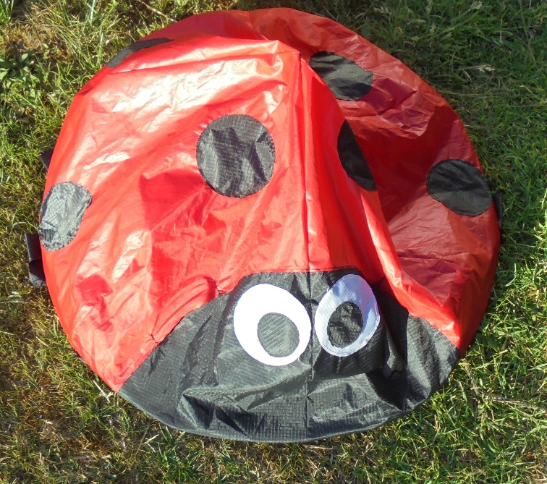
Now we come to the “interesting” bit. Cut out a 60cm diameter (58cm if you have not added seam allowances) circle of heavy ripstop or light weigh canvas. To mark this out I drilled 2 small holes 30cm apart in an aluminium strip. One of the holes went over a drawing pin inserted through the material then with a marker through the other hole I could draw my circle. (Using a metal strip also means you can insert the tip of your cutting iron and hot cut your circle.)
Now turn the body inside out with the legs and tape loop inwards and lay the base over it. Next sew round the base, overlapping the body panels, all the way round. This should fit exactly but with variations in sewing styles may well require some careful “adjustments”. I started at the centre front and worked about a third of the way round on each side, then trimmed the base to fit.
OK that done all you have to do is reach in through one of the inflation vents and turn the whole thing the right way out. Attach a line to the loop and fix to a ground anchor. They work best on a flat, hard, sandy surface with a steady breeze. (E.G. Fano or Broad Haven). Each will inflate at different rates due to material weight and porosity.
That’s my first one.
I hope you found this helpful.

Slide 16
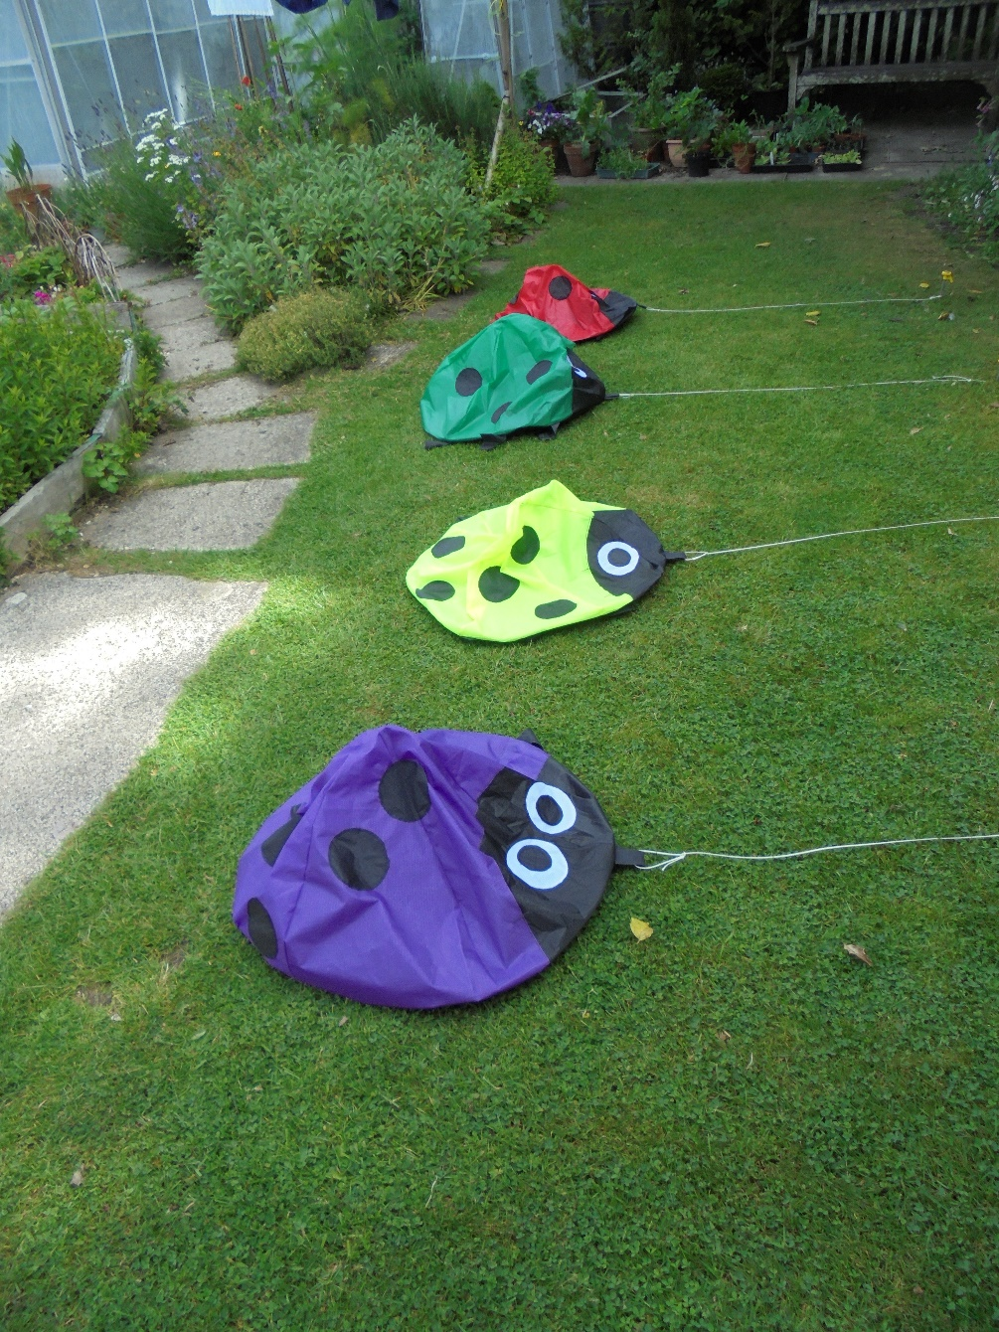
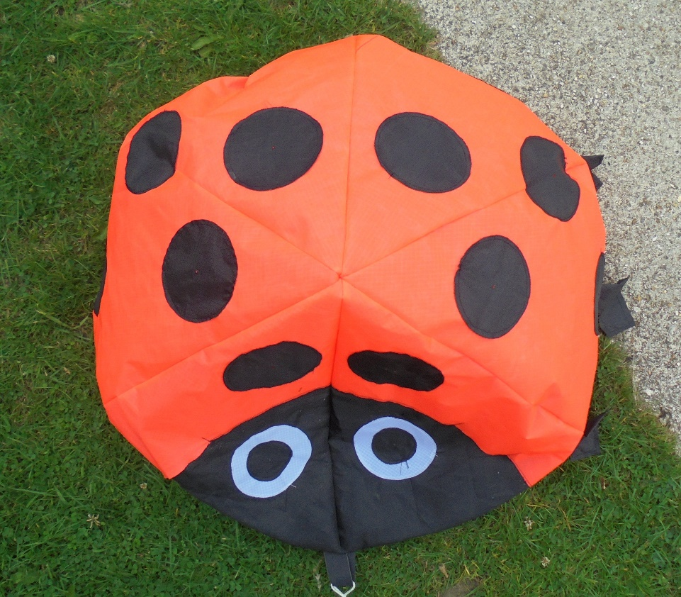
They have started multiplying!!!!!

